Slide 1
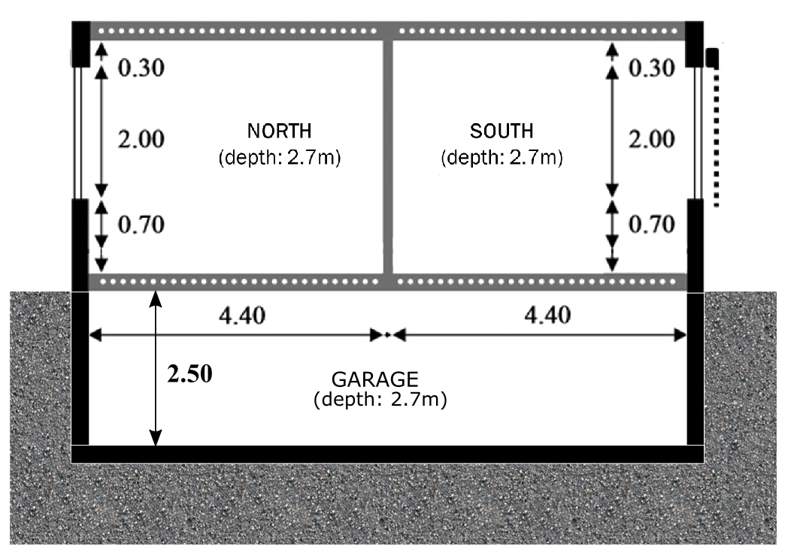

IDEAS | Buildings
Example
.crash course
13 October 2016
Notes:
10’ - JModelica (demo)
5’ - Tutorials and reference documentation (slides)
30’ - Libraries: MSL and own libraries (dymola demo)
10’ - simman and pymosim (python demo)
5’ - Coding conventions (slides)
5’ - Dymola licenses at TME (slides)
1u05 min

Slide 2
Building
Climate
Ventilation system
Structure
Heating system
Electric in-home grid
Electric grid
Occupants
District heating network
Notes:
The first part to model into a building should be the envelope

Slide 3
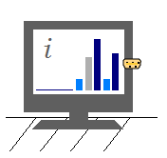
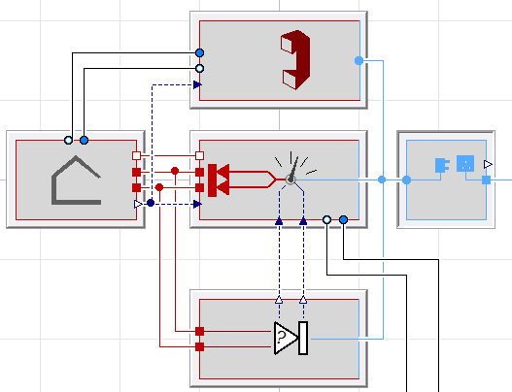
IDEAS.Templates.Interfaces.Building
Notes:
IDEAS will provide a template, however I do not use it. Just part by part

Slide 4
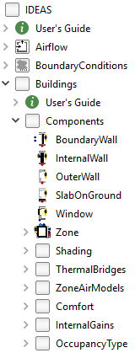

IDEAS.Buildings.Components
boundary wall
ZONE
outer wall
window
internal wall
slab on ground
Notes:
Types of wall

Slide 5
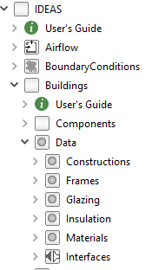
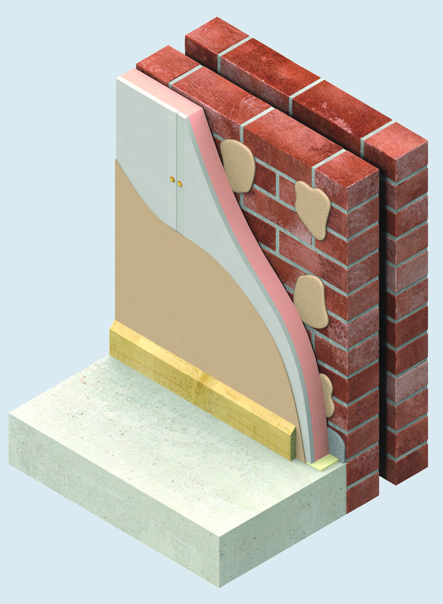
IDEAS.Buildings.Data
6
5
4
3
2
1
Materials
Construction
Notes:
Create your own walls composition and materials!

Slide 6
IDEAS | example
Low energy building
Notes:
10’ - JModelica (demo)
5’ - Tutorials and reference documentation (slides)
30’ - Libraries: MSL and own libraries (dymola demo)
10’ - simman and pymosim (python demo)
5’ - Coding conventions (slides)
5’ - Dymola licenses at TME (slides)
1u05 min

Slide 7
Envelope components
Materials
Composition (out→in or propsBus b→a)
Floor | Tile (d=0.01) | Screed (0.06)* | PUR (0.04) | Concrete (0.20) | Plaster (0.02)
Ceiling | Slate(d=0.01) | PUR(0.18) | Concrete(0,20)
Exterior wall | Brick (0.10) | MW (0.16) | Brick (0.14) | Plaster (0.02)
Interior wall | Plaster (0.02) | Brick (0.10) | Plaster (0.02)
Slab | Concrete(0.35) | Screed(0.05)
* Floor heating tube is situated at position 2 (between Screed and PUR)
 | λ (W/mK) | c (J/kgK) | ρ (kg/m³)
Tile | 1.4 | 840 | 2100
Screed | 0.6 | 860 | 1100
Concrete | 1.7 | 840 | 2400
Plaster | 0.6 | 840 | 975
Brick | 1.1 | 840 | 1850
Slate | 2.01 | 760 | 2700
Mineral wool | 0.036 | 840 | 110
PUR | 0.02 | 1470 | 30
Notes:
10’ - JModelica (demo)
5’ - Tutorials and reference documentation (slides)
30’ - Libraries: MSL and own libraries (dymola demo)
10’ - simman and pymosim (python demo)
5’ - Coding conventions (slides)
5’ - Dymola licenses at TME (slides)
1u05 min

Slide 8
Windows
Glazing: Saint Gobain Clima Plus Futur (U = 1.4 W/m²K, g = 0.755)
Frame: U-value=2.5 W/m²k , fraction of the window: f=0.15
Shadowing: On south window
Window Size: 2m x 1m
Infiltration: n₅₀=0.6 ACH
Ventilation: 36 m³/h per zone, recuperation efficiency 65%
Heating system: ideal heating via radiators or floor heating
Occupancy: 7am-5pm
Set point: 21ºC when occupied, 15 ºC otherwise
Heat gains: 20 W/m² when occupied, 2 W/m² otherwise
Notes:
10’ - JModelica (demo)
5’ - Tutorials and reference documentation (slides)
30’ - Libraries: MSL and own libraries (dymola demo)
10’ - simman and pymosim (python demo)
5’ - Coding conventions (slides)
5’ - Dymola licenses at TME (slides)
1u05 min

